Slide 1
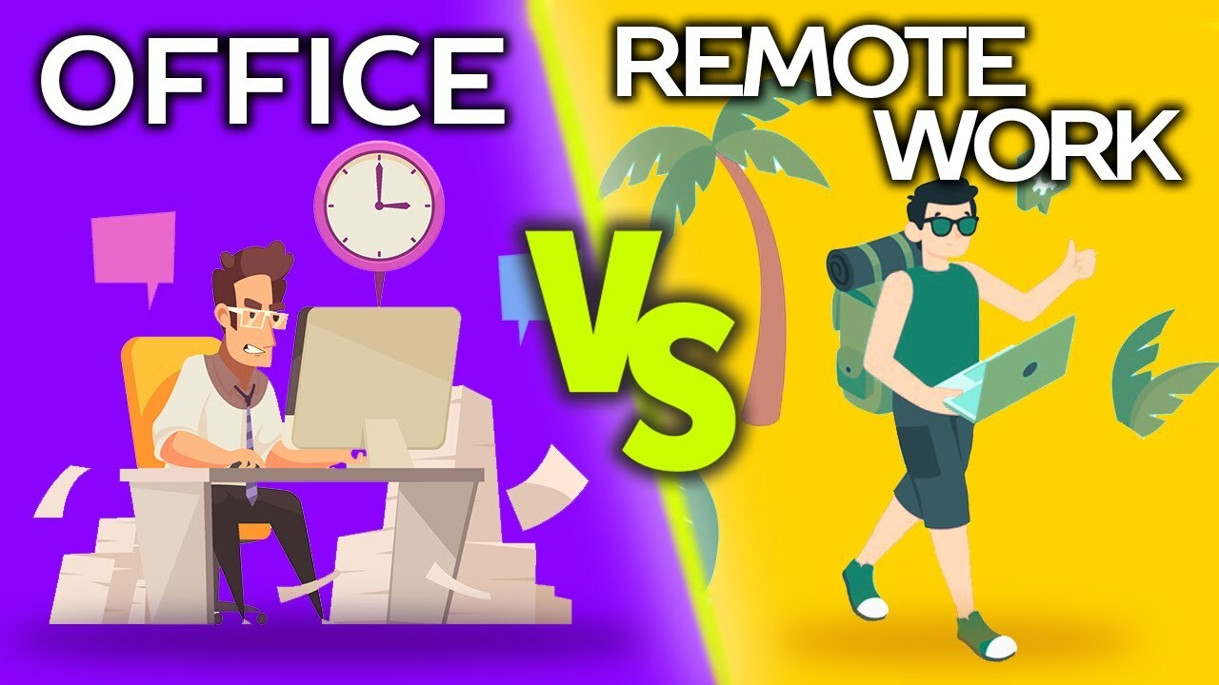
The Impact of Work Location on Employee Satisfaction and Productivity
Team Members:
Bhagi Laksumanage
Luke O’Malley
Maher Mubarak
Jarvis Cathy

Slide 2

Project Overview
As remote work becomes the new norm, it's essential to understand its impact on employees' mental well-being and productivity.
What are the effects of remote work on employee satisfaction and productivity?
Are employees working fully remote, hybrid or onsite most likely to be satisfied and perform at a higher productivity level?
This project seeks to answer the above questions.

Slide 3
Project Purpose and Benefit
This analysis could help businesses, HR professionals, and researchers assess the growing influence of remote work on productivity and well-being
Make relevant decisions that would benefit both employees and companies in the long run.

Slide 4
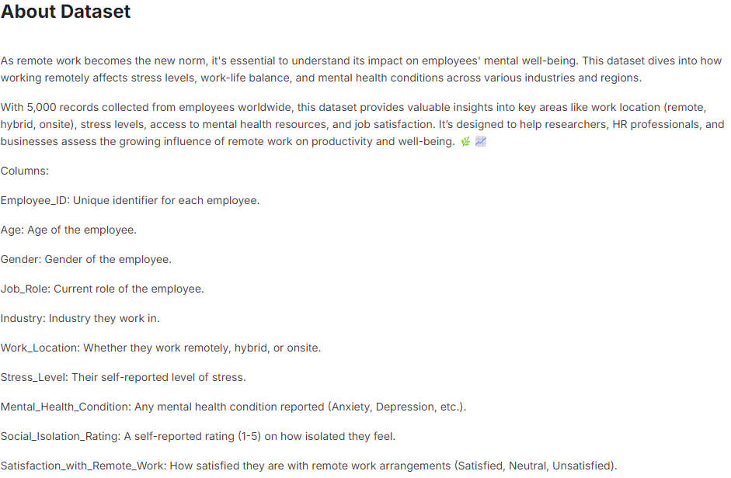
Data Set
We used a data set obtained from Kaggle that contained data across various industries and different regions of the world. The data provided valuable insights into how factors such as the number of hours worked, number of virtual meetings, mental health condition and job role affect employee satisfaction and productivity.
https://www.kaggle.com/datasets/waqi786/remote-work-and-mental-health/data

Slide 5
Data Set
Our data set consisted of the following data columns:
Target Variables:
Satisfaction
Productivity
Feature Variables:
Employee ID
Age
Gender
Job Role
Work Location
Hours Worked Per Week
Number of Virtual Meetings
Mental Health Condition
Access to Mental Health Resources
Physical Activity
Sleep Quality
Region

Slide 6
Process Outline
1)Data Cleansing and Preprocessing
2)Data Analysis
3)Machine Learning Models - Built and Evaluated three types of Models
4)Testing
5)Model Predictions
6)Conclusions

Slide 7
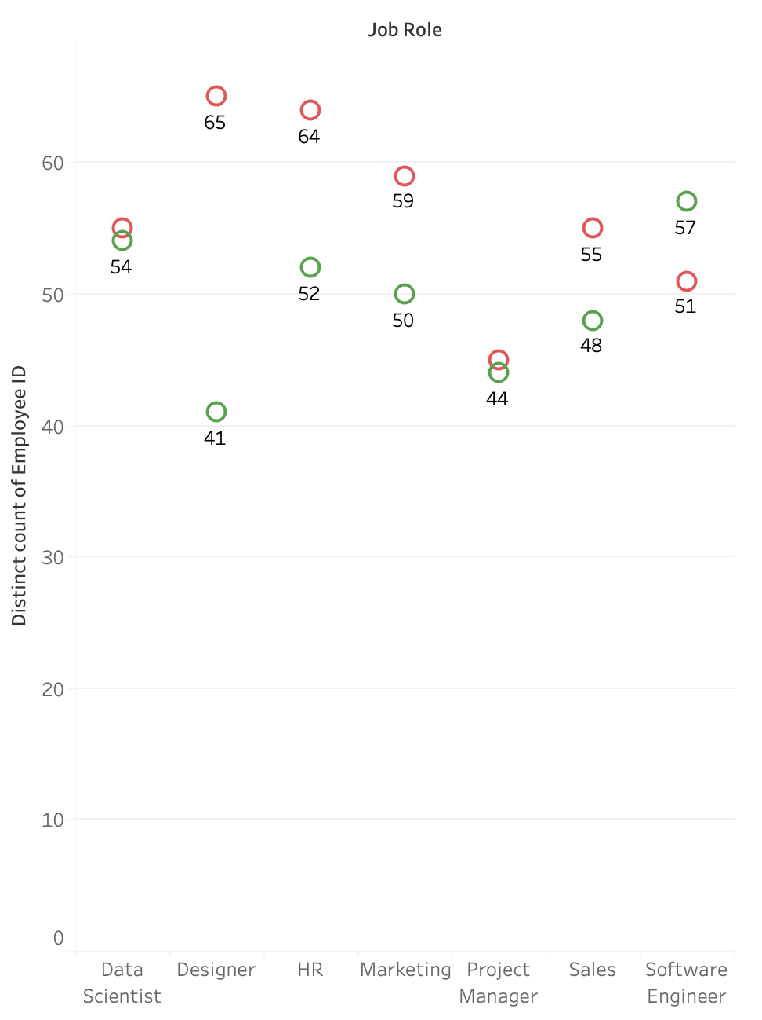
Employee Job Satisfaction Based on Work Location

Slide 8
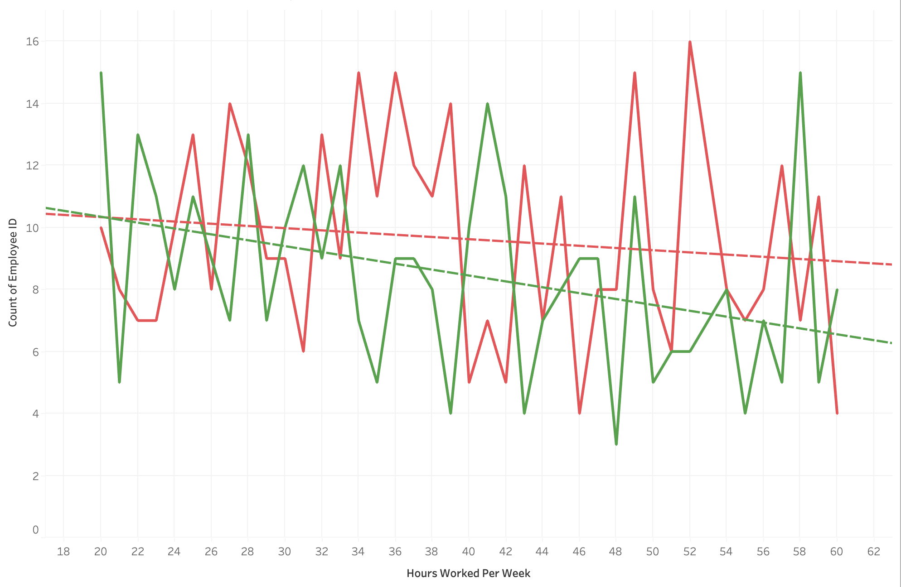
Hours Worked Per Week vs. Employee Satisfaction Based on Work Location

Slide 9
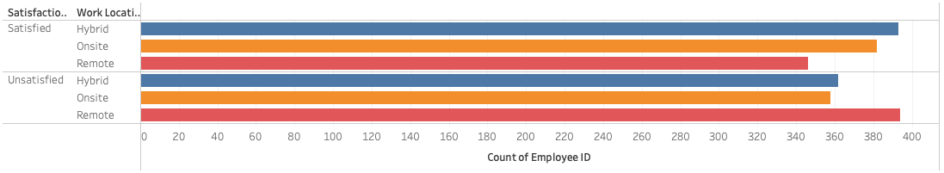
Work Location Vs Employee Satisfaction

Slide 10
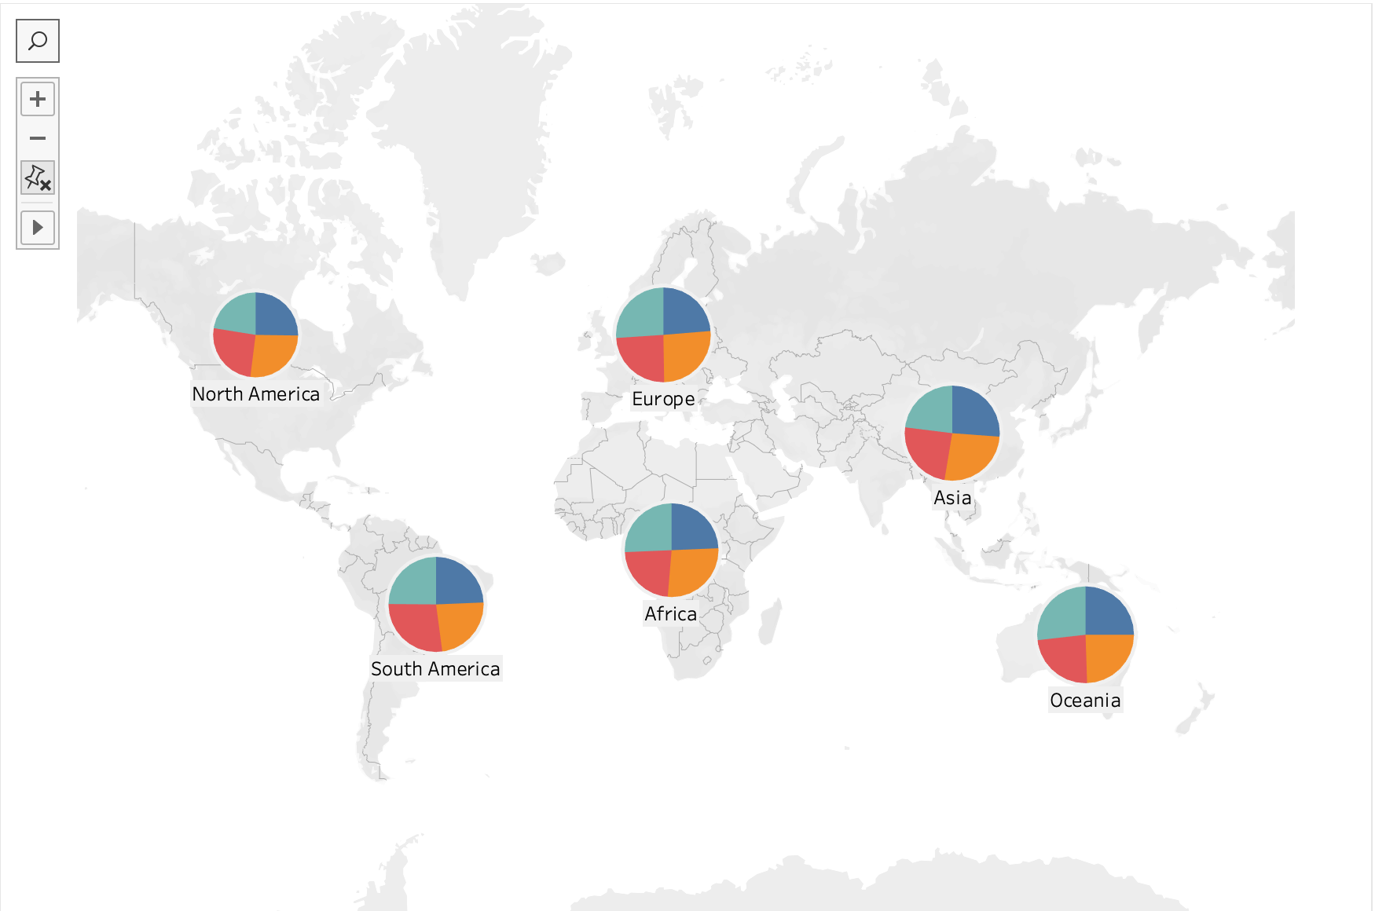
Mental Health Condition Based on Region

Slide 11
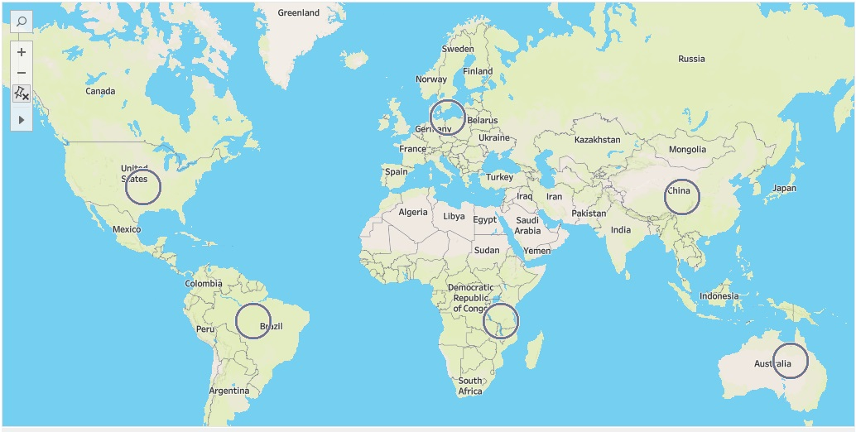
Region Based on Sleep Quality
https://public.tableau.com/app/profile/jay.cat/viz/Project4Group/Region?publish=yes

Slide 12
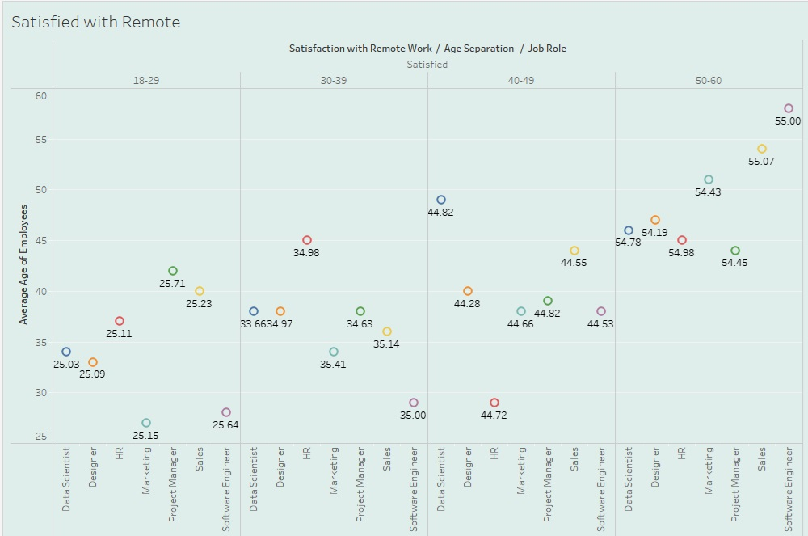
Satisfied with Remote Work vs Job Role

Slide 13
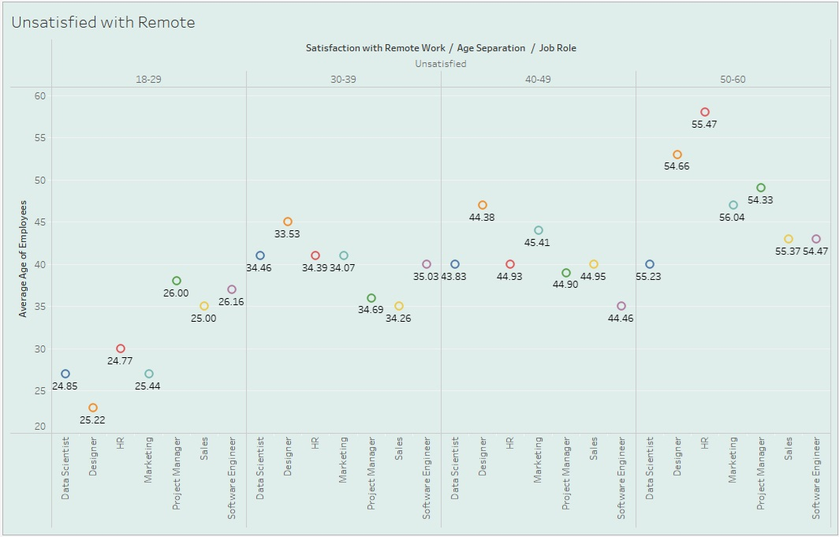
Unsatisfied with Remote Work vs Job Role

Slide 14
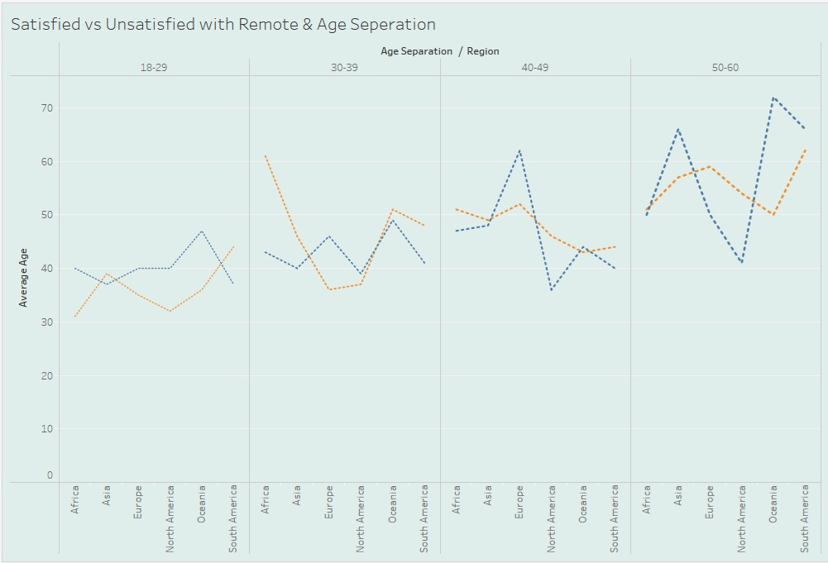
Satisfied vs Unsatisfied with Remote Work & Age Seperation

Slide 15
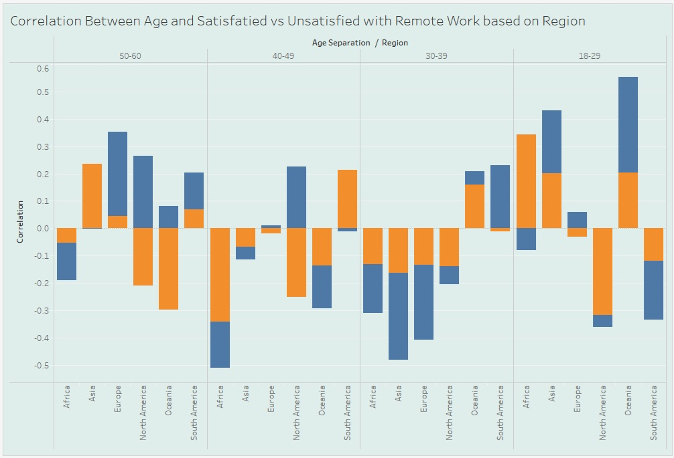
Correlation Between Age & Satisfaction with Remote Work

Slide 16
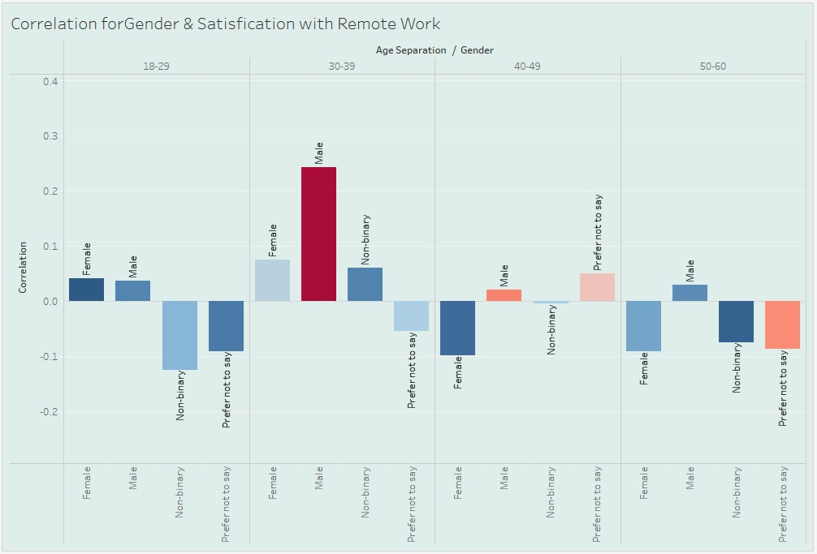
Correlation for Gender & Satisfication with Remote Work

Slide 17
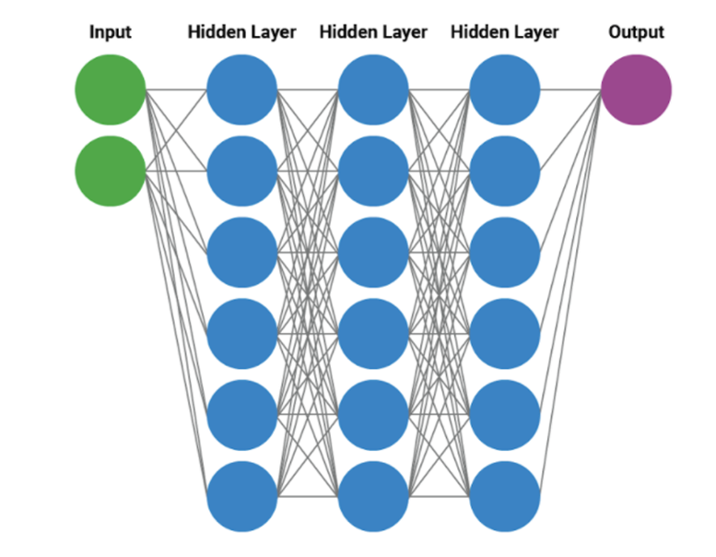
Neural Network - Deep Learning Model

Slide 18
Neural Network Model
Process
Split the data set, scale and standardize each feature.
Fit the model to our training data
Transform the data
Create a sequential model
Compile and run Model
Model Prediction and accuracy report

Slide 19
Neural Network Model
Deep Learning Model to predict Employee Satisfaction and Employee Productivity
A separate neural network model to predict each target variable.
Started off with a simple neural network model and increased its complexity to improve accuracy.
Testing Phase:
Actions taken to improve accuracy:
Increased number of neurons per hidden layer
Increased the number of hidden layers
Changed the number of epochs
Binning
Principal Component Analysis

Slide 20
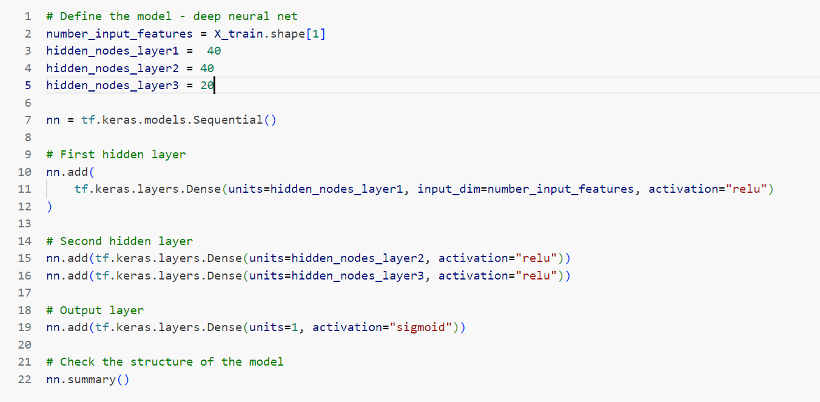
Neural Network - Deep Learning Model Definition

Slide 21
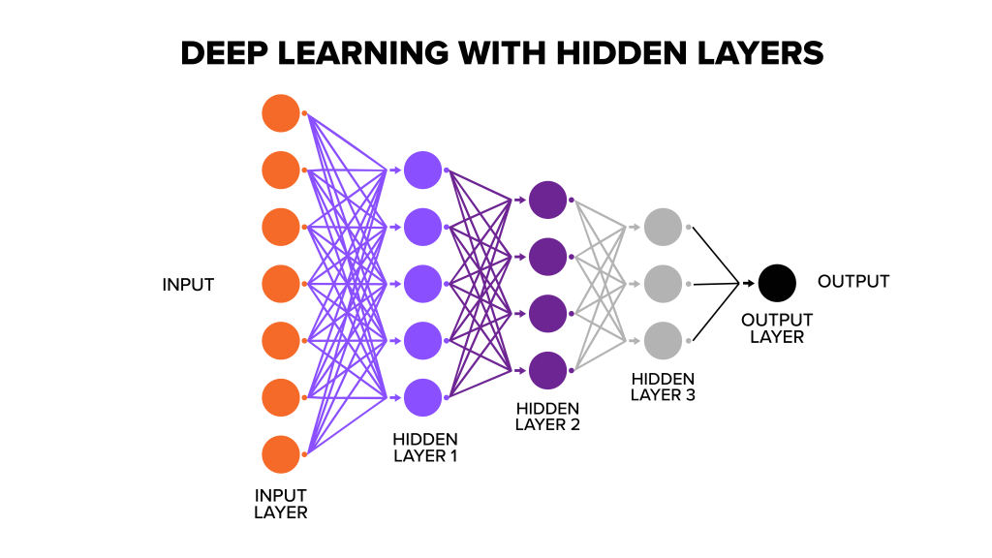
Neural Network Model Definition
Our Optimal Model:
Input Layer : 33 Neurons
Hidden Layer 1: 40 Neurons
Hidden Layer 2: 40 Neurons
Hidden Layer 3: 20 Neurons
Output Layer: 1
Epochs: 30

Slide 22
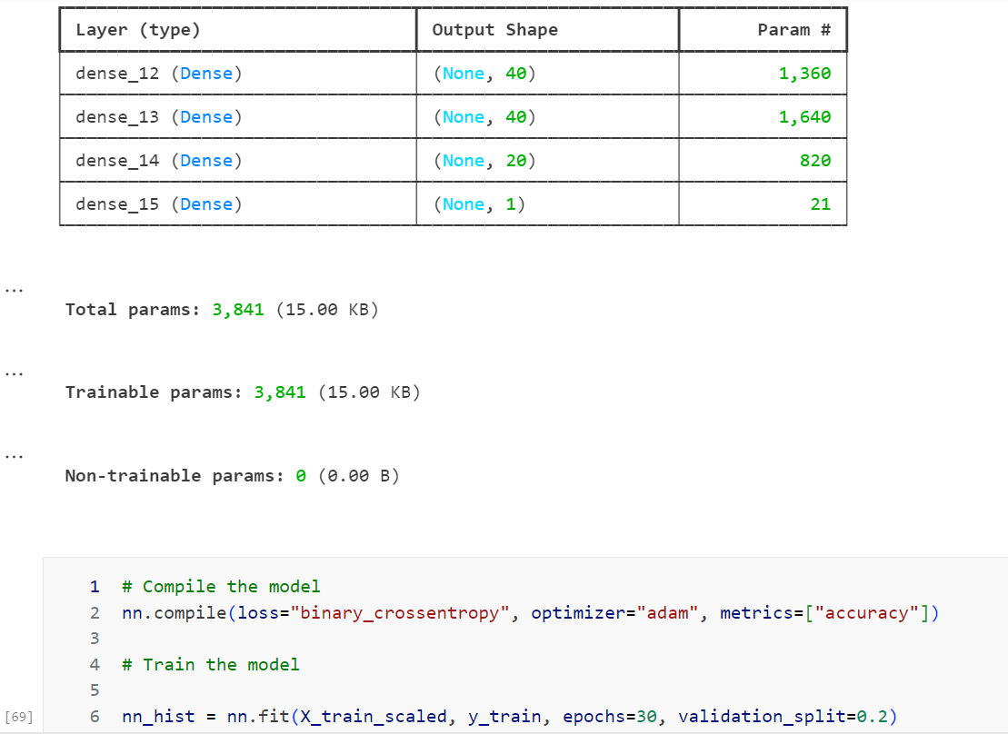
Neural Network Model Definition

Slide 23
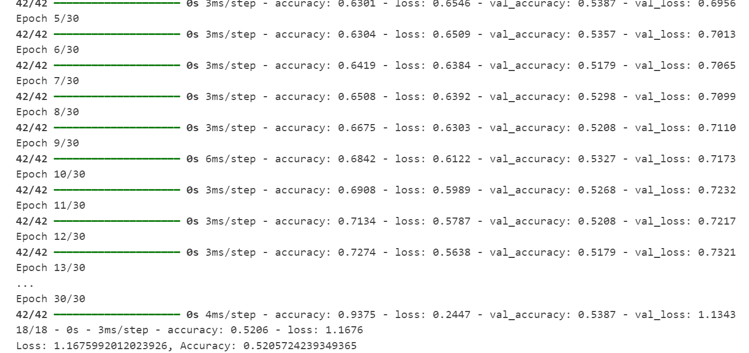
Neural Network Model Accuracy
Model Accuracy :
For Training Data:
Accuracy: 93%
Loss: 0.24
For Testing Data
Accuracy : 52%
Loss: 1.16

Slide 24
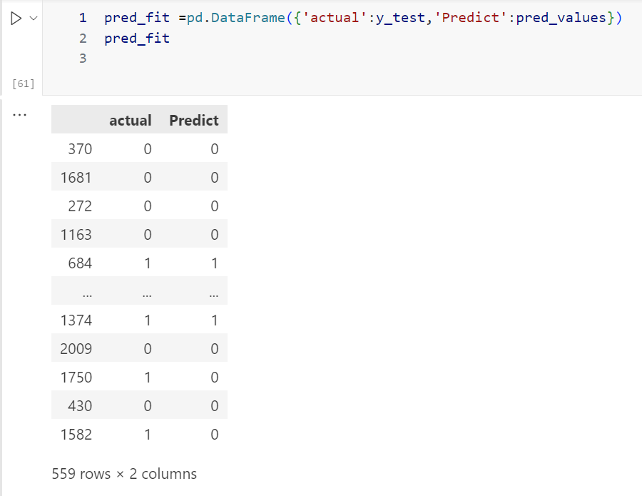
Neural Network Model - Actual Vs Predicted values

Slide 25
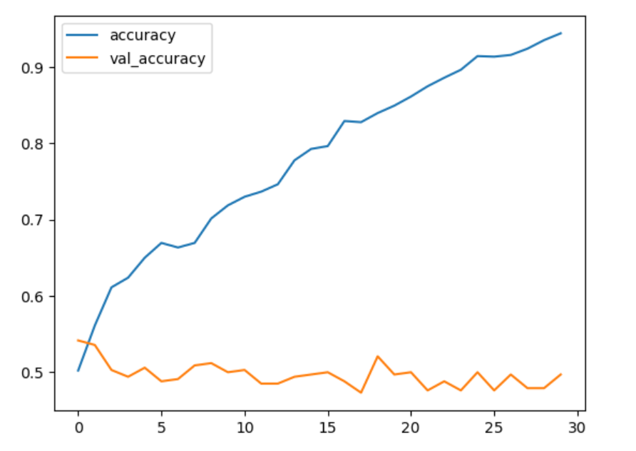
Training Data Accuracy Vs Testing Data Accuracy
Accuracy of training data vs Testing data plotted against number of epochs.
accuracy - training data
val_accuracy - testing data

Slide 26
Neural Network Deep Learning Model - Accuracy
Possible Reasons for low accuracy
Over Fitting
1)We believe the data adjusted too much to fit the training data and did not generalize well when fitting and predicting test data
Lack of Complexity of Data
Another possible cause could be the uniformity of data specifically the non categorical data in which the unique values were distributed evenly among the population and hence lack of variability in the dispersion.
Evaluating Alternative Models for Accuracy
To further improve accuracy we evaluated two additional models to find out if the accuracy would improve with the same data set. The alternate models we built and evaluated were a logistic regressions model and a Decision Tree Model.

Slide 27
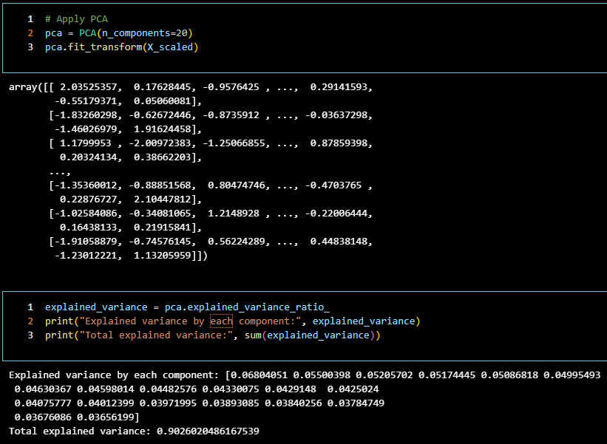
Logistic Regression
Model - PCA Application
Due to the dataset’s large number of features, we used PCA to extract the important information before running our Logistic Regression model
Number of components: 20
Total Explained Variance: 0.9026

Slide 28
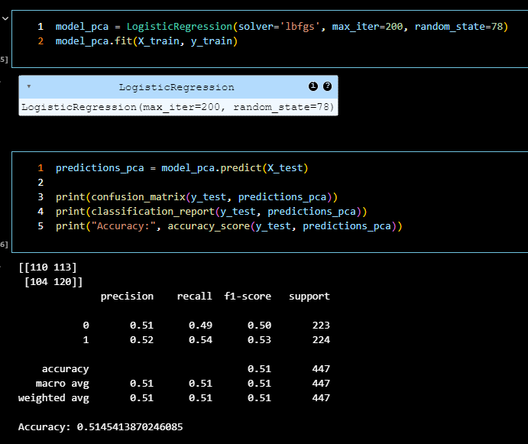
Logistic Regression Model Performance
Accuracy: 51.45%
We also tried decreasing the number of principal components to improve the model’s accuracy, but when going below 20 components, the total explained variance dropped drastically

Slide 29
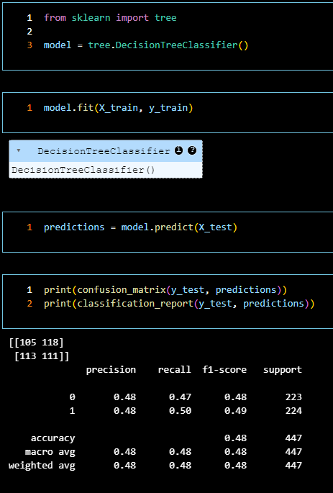
Decision Tree Model
Accuracy: 48%
Decision Trees can be prone to bias and overfitting, as evidenced in the plot of our model on the next slide

Slide 30
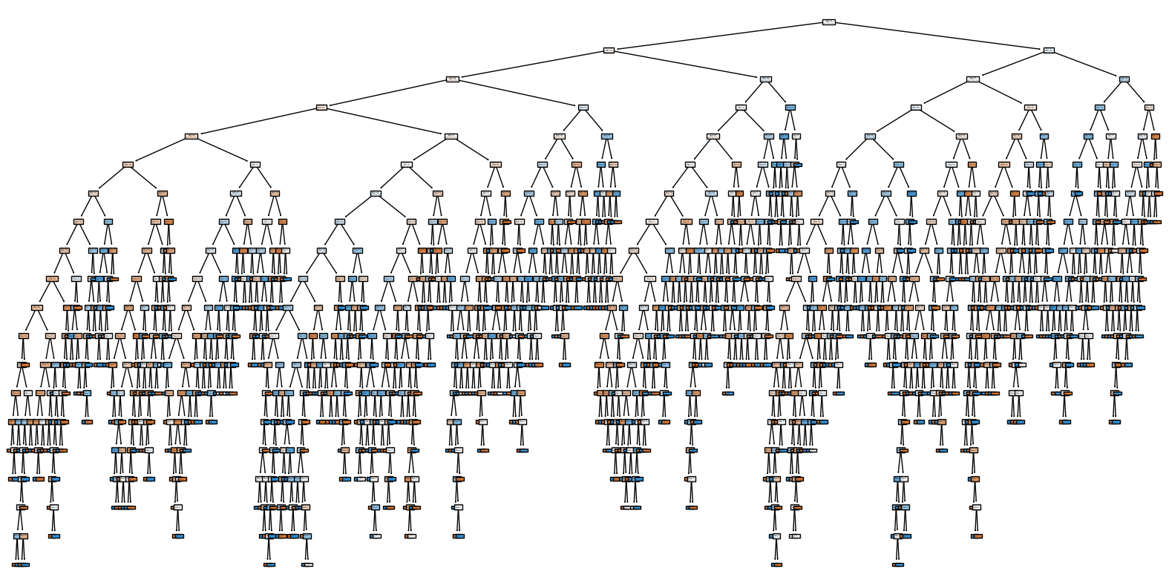
Decision Tree Plot

Slide 31
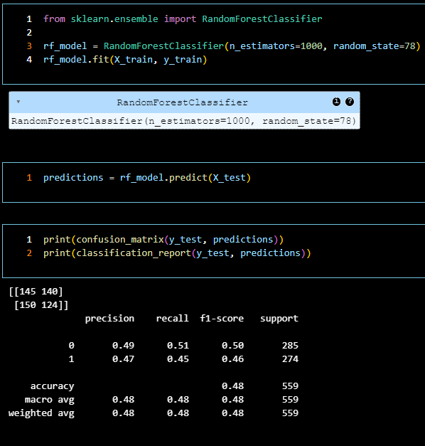
Random Forest Model
Random Forest models use multiple decision trees during training, building each tree with a random subset of the data
Accuracy: 48%

Slide 32
Recommendations/Findings
The Neural Network adjusted too much to fit the training data and was not able to generalize well when applying it to the testing data
There was not enough complexity in the data, causing the Neural Network model to converge too quickly
The Decision Tree and Random Forest models saw overfitting due to the dataset’s uniform distribution among its features
Find A Different/Larger Dataset: When analyzing this set, we discovered many of the variables were evenly distributed and too uniform to glean much insight into which actually have a significant impact on employee satisfaction and productivity

